Slide 1

DISCUSSION: FINAL TUTORIAL
In lieu of a final exam, you’ll create a mini-tutorial that:
Identifies a raw data source
Processes and stores that data
Performs exploratory data analysis & visualization
Derives insight(s) using statistics and ML
Communicates those insights as actionable text
Individual or group project – 20% of final grade!
Will be hosted publicly online (GitHub Pages) and will strengthen your portfolio.

Slide 2
DISCUSSION: FINAL TUTORIAL
Deliverable: URL of your own GitHub Pages site hosting an .ipynb/.html export of your final tutorial
https://pages.github.com/ – make a GitHub account, too!
https://github.com/blog/1995-github-jupyter-notebooks-3
The project itself:
~1500+ words of Markdown prose
~150+ lines of Python
Should be viewable as a static webpage – that is, if I (or anyone else) opens the link up, everything should render and I shouldn’t have to run any cells to generate output

Slide 3
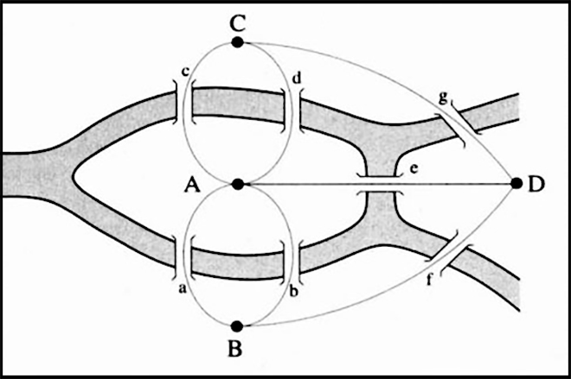
AND NOW!
Graph Processing
Representing graphs
Centrality measures
Community detection
Natural Language Processing
Bag of Words, TF-IDF, N-grams
(If we get to this today …)
Thank you to: Sukumar Ghosh (Iowa), Lei Tang (Yahoo!), Huan Liu (ASU), Zico Kolter (CMU)
https://en.wikipedia.org/wiki/Seven_Bridges_of_Königsberg

Slide 4

NETWORKS? GRAPHS?
Networks are systems of interrelated objects
Graphs are the mathematical models used to represent networks
In data science, we will use algorithms on graphs to answer questions about real-world networks.
Trump
Obama

Slide 5
GRAPHS
Nodes = Vertices
Edges = Arcs
A graph G = (V,E) is a set of vertices V and edges E
Edges can be undirected or directed
A
C
A
C
B
D
B
D
V = {A, B, C, D}
E = {(A,B), (B,C), (C,D), (A,C)}
V = {A, B, C, D}
E = {(A,C), (C,A), (B,C), (B,D)}
Examples of directed vs undirected graphs ????????????

Slide 6
GRAPHS
Edges can be unweighted or weighted
Unweighted 🡪 all edges have unit weight
A
C
A
1
C
2
4
4
B
D
B
D
Unweighted
Weighted
Examples of unweighted and weighted graphs ????????????

Slide 7
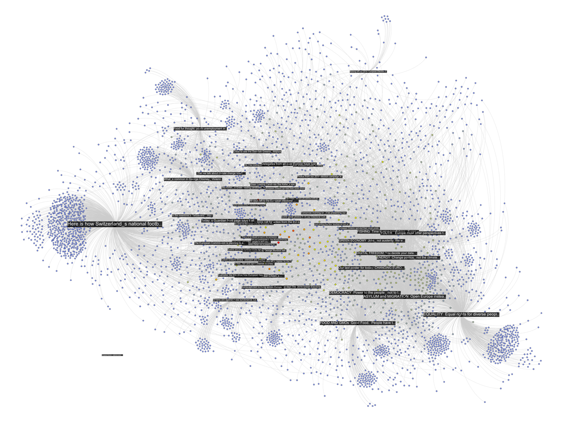
GRAPHS AND THE NETWORKS THEY REPRESENT
Facebook posts (in black), and users liking or commenting on those posts
http://thepoliticsofsystems.net/category/network-theory/

Slide 8
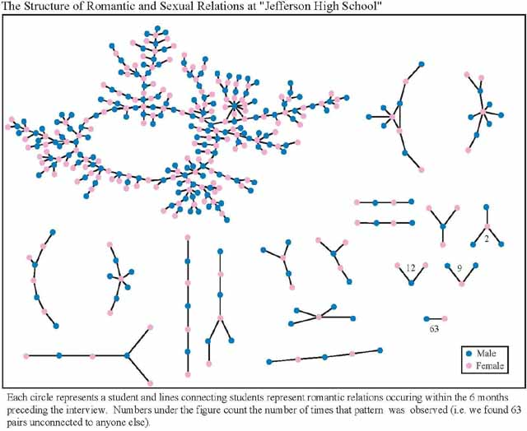
GRAPHS AND THE NETWORKS THEY REPRESENT

Slide 9
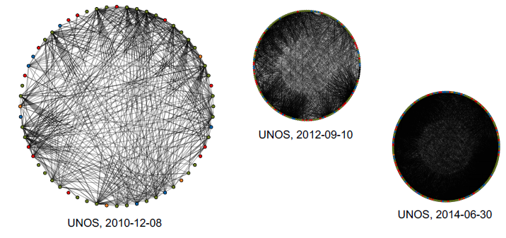
GRAPHS AND THE NETWORKS THEY REPRESENT
UNOS, 2012-09-10

Slide 10
NETWORKX
NetworkX is a Python library for storing, manipulating, and analyzing (small- and medium-sized) graphs
Uses Matplotlib for rendering
https://networkx.github.io/
conda install -c anaconda networkx
import networkx as nx
G=nx.Graph()
G.add_node("spam”)
G.add_edge(1,2)
print(list(G.nodes()))
print(list(G.edges())) [(1, 2)
[1, 2, ‘spam’]
[(1,2)]
Notes:
Useful to use it for defaults
but useful to know your use cases to use a different package to represent stuff

Slide 11
STORING A GRAPH
Three main ways to represent a graph in memory:
Adjacency lists
Adjacency dictionaries
Adjacency matrix
The storage decision should be made based on the expected use case of your graph:
Static analysis only?
Frequent updates to the structure?
Frequent updates to semantic information?

Slide 12
ADJACENCY LISTS
For each vertex, store an array of the vertices it connects to
Pros: ????????
Iterate over all outgoing edges; easy to add an edge
Cons: ????????
Checking for the existence of an edge is O(|V|), deleting is hard
A
C
Vertex | Neighbors
A | [C]
B | [C, D]
C | [A]
D | []
B
D

Slide 13
ADJACENCY DICTIONARIES
For each vertex, store a dictionary of vertices it connects to
Pros: ?????????
O(1) to add, remove, query edges
Cons: ?????????
Overhead (memory, caching, etc)
A
C
Vertex | Neighbors
A | {C: 1.0}
B | {C: 1.0, D: 1.0}
C | {A: 1.0}
D | {}
B
D

Slide 14
ADJACENCY MATRIX
Store the connectivity of the graph in a matrix
Cons: ?????????
O(|V|²) space regardless of the number of edges
Almost always stored as a sparse matrix
From
A
C
 | A | B | C | D
A | 0 | 0 | 1 | 0
B | 0 | 0 | 0 | 0
C | 1 | 1 | 0 | 0
D | 0 | 1 | 0 | 0
To
B
D

Slide 15
NETWORKX STORAGE
NetworkX uses an adjacency dictionary representation
Built-ins for reading from/to SciPy/NumPy matrices
# Make a directed 3-cycle
G=nx.DiGraph()
G.add_edges_from([(‘A’,’B’), (‘B’, ‘C’), (‘C’, ‘A’)])
# Get all out-edges of vertex ’B’
print(G[‘B’])
# Loop over vertices
for v in G.nodes(): print(v)
# Loop over edges
for u,v in G.edges(): print(u, v)

Slide 16
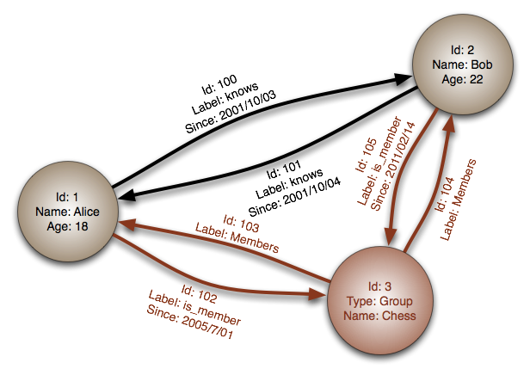
ASIDE: GRAPH DATABASES
Traditional relational databases store relations between entities directly in the data (e.g., foreign keys)
Queries search data, JOIN over relations
Graph databases directly relate data in the storage system using edges (relations) with attached semantic properties
Image thanks to Wikipedia

Slide 17
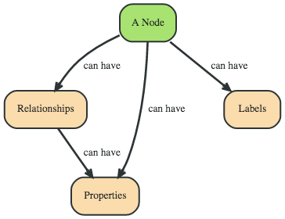
EXAMPLE GRAPH DATABASE
Two people, John and Sally, are friends. Both John and Sally have read the book, Graph Databases.
Nodes ??????????
John
Sally
Graph Databases
Thanks to: http://neo4j.com

Slide 18
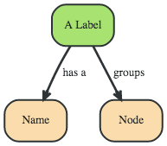
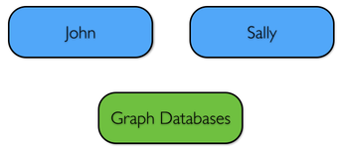
EXAMPLE GRAPH DATABASE
Two people, John and Sally, are friends. Both John and Sally have read the book, Graph Databases.
Labels ??????????
Person
Book
A named construct that groups nodes into sets
Next: assign labels to the nodes

Slide 19
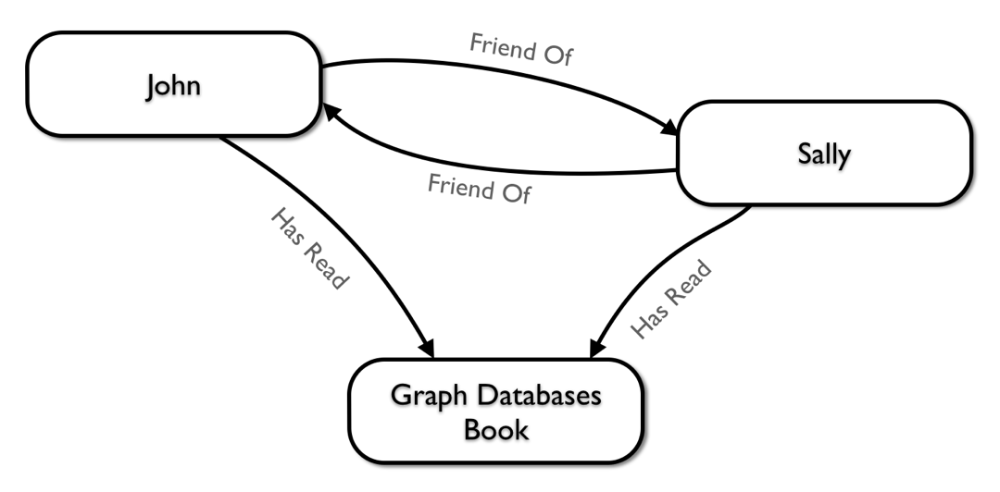
EXAMPLE GRAPH DATABASE
Two people, John and Sally, are friends. Both John and Sally have read the book, Graph Databases.
Relationships ????????
John is a friend of Sally; Sally is a friend of John
John has read Graph Databases; Sally has read Graph Databases

Slide 20
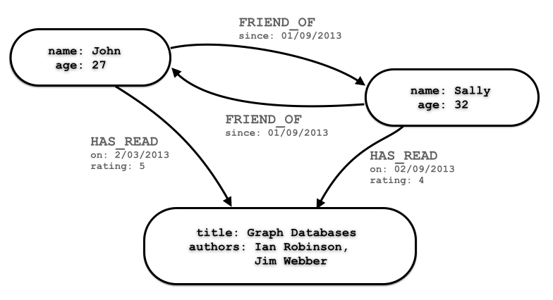
EXAMPLE GRAPH DATABASE
Can associate attributes with entities in a key-value way
Attributes on nodes, relations, labels

Slide 21
EXAMPLE GRAPH DATABASE
Querying graph databases needs a language other than SQL
Recall: graph databases explicitly represent relationships
Adhere more to an object-oriented paradigm
May be more suitable for managing ad-hoc data
May scale better, depending on the query types (no JOINs)
# When did Sally and John become friends?
MATCH (sally:Person { name: 'Sally' })
MATCH (john:Person { name: 'John' })
MATCH (sally)-[r:FRIEND_OF]-(john)
RETURN r.since AS friends_since
Cypher query

Slide 22



BULBFLOW
Many graph databases out there:
List found here: https://en.wikipedia.org/wiki/Graph_database
neo4j and Titan are popular, easy-to-use solutions
https://neo4j.com/
http://titan.thinkaurelius.com/
Bulbflow is a Python framework that connects to several backing graph-database servers like neo4j
http://bulbflow.com/

Slide 23
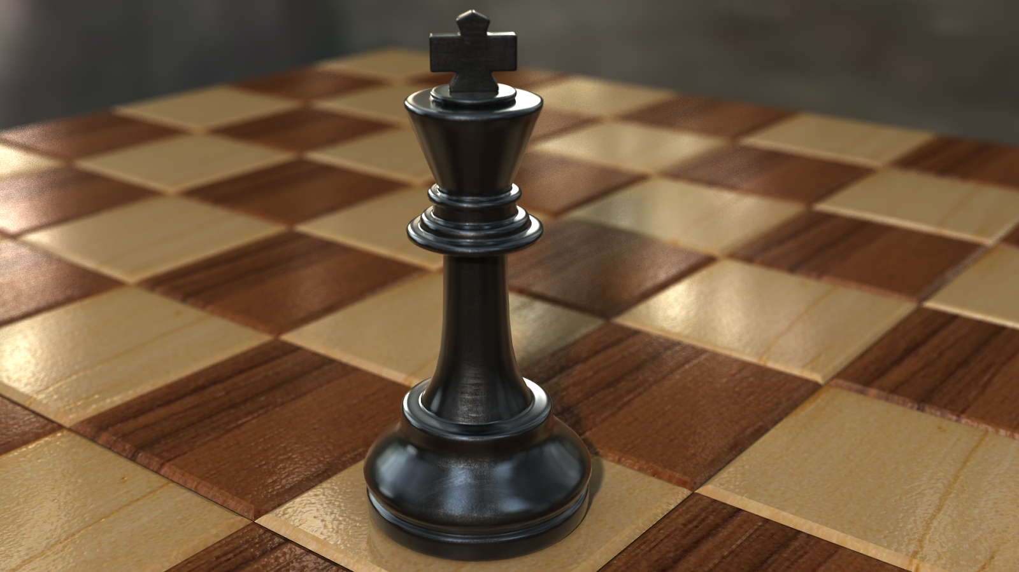
THE VALUE OF A VERTEX

Slide 24
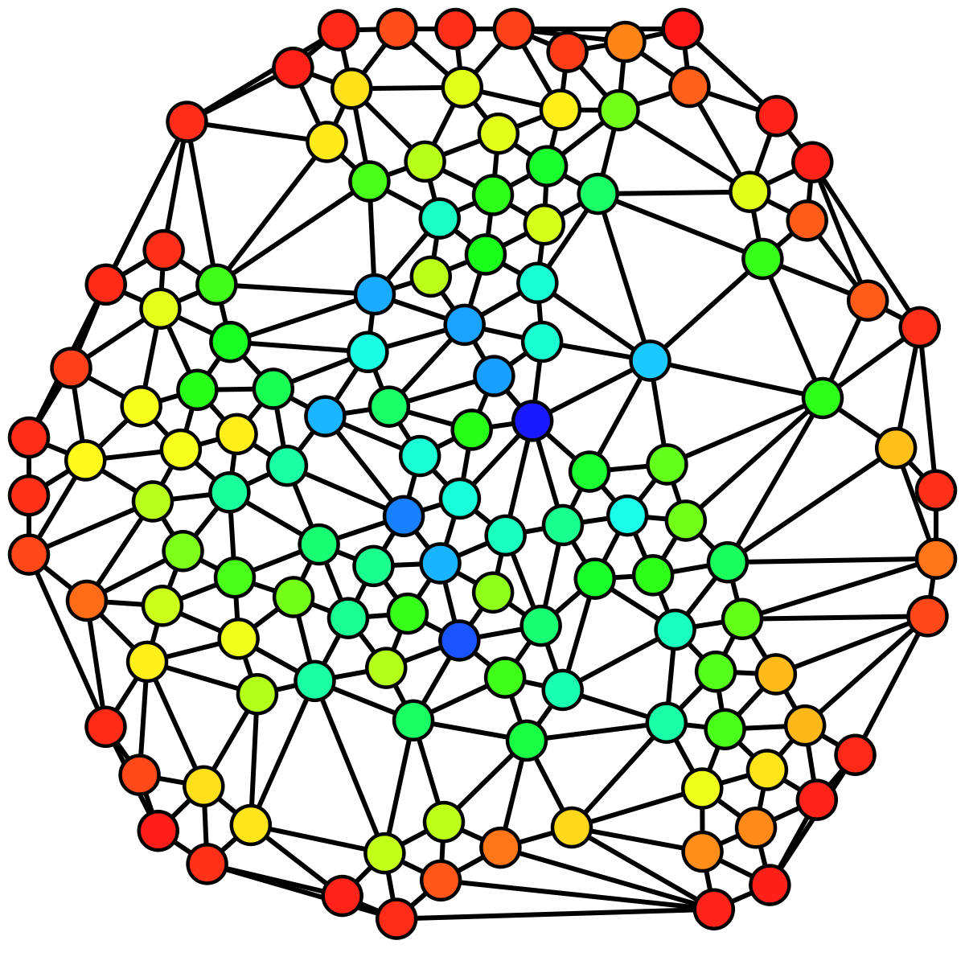
IMPORTANCE OF VERTICES
Not all vertices are equally important
Centrality Analysis:
Find out the most important node(s) in one network
Used as a feature in classification, for visualization, etc …
Commonly-used Measures
Degree Centrality
Closeness Centrality
Betweenness Centrality
Eigenvector Centrality

Slide 25
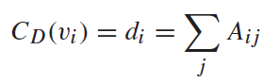
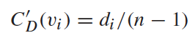
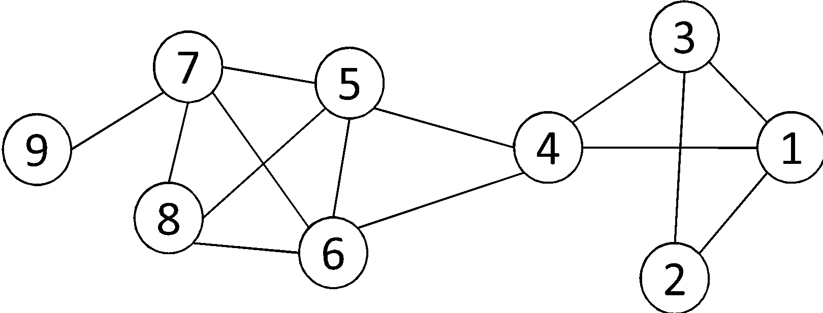
DEGREE CENTRALITY
The importance of a vertex is determined by the number of vertices adjacent to it
The larger the degree, the more important the vertex is
Only a small number of vertex have high degrees in many real-life networks
Degree Centrality:
Normalized Degree Centrality:
For vertex 1, degree centrality is 3;
Normalized degree centrality is
3/(9-1)=3/8.
Notes:
“A small number of nodes have high degrees” thanks to the power law

Slide 26
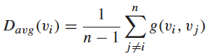
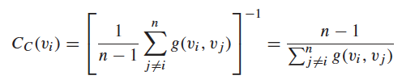
CLOSENESS CENTRALITY
“Central” vertices are important, as they can reach the whole network more quickly than non-central vertices
Importance measured by how close a vertex is to other vertices
Average Distance:
Closeness Centrality:

Slide 27
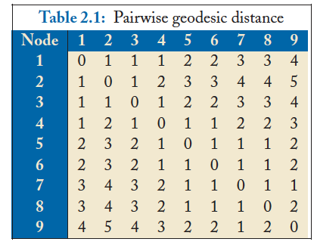
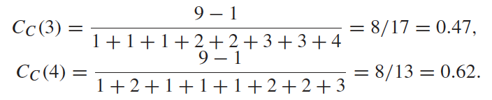
CLOSENESS CENTRALITY
Vertex 4 is more central than vertex 3

Slide 28
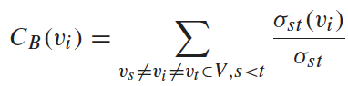
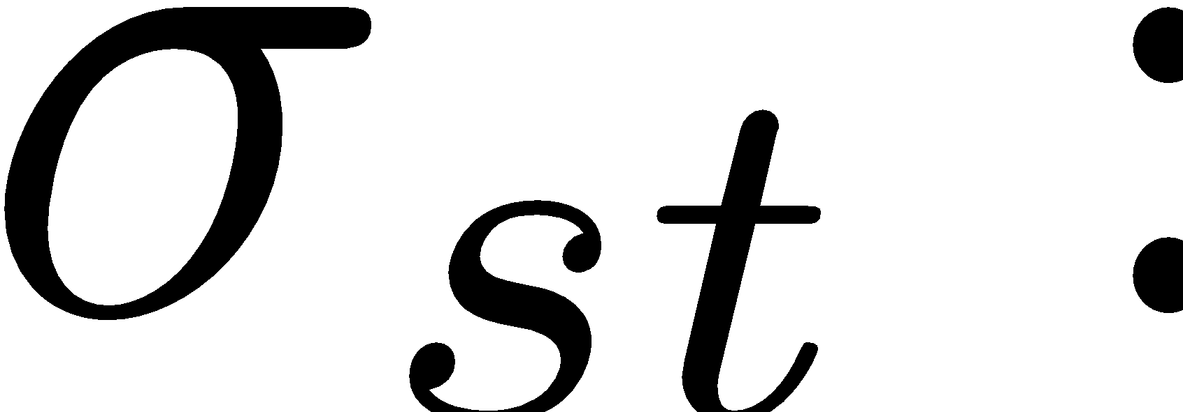
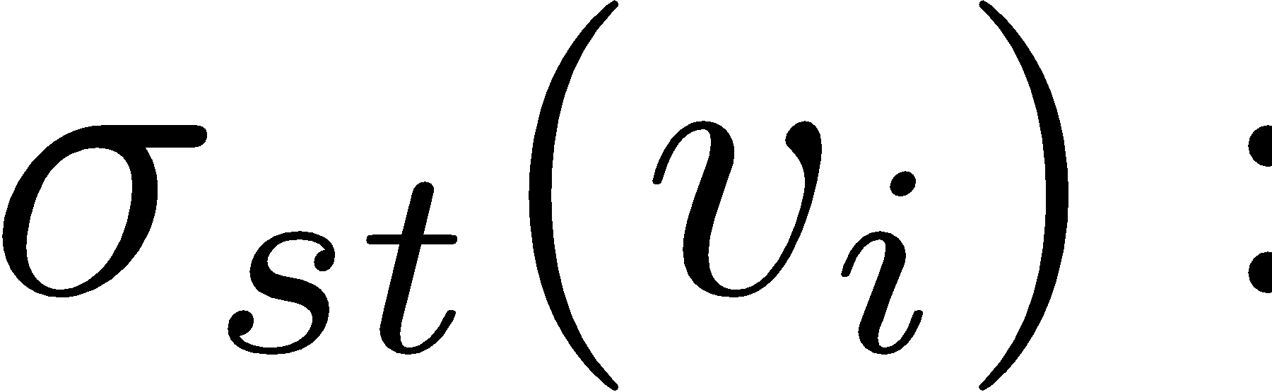
BETWEENNESS CENTRALITY
Vertex betweenness counts the number of shortest paths that pass through one vertex
Vertices with high betweenness are important in communication and information diffusion
Betweenness Centrality:
The number of shortest paths between s and t
The number of shortest paths between s and t that pass v_{i}

Slide 29
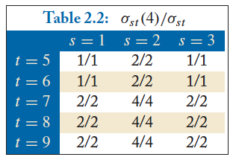
BETWEENNESS CENTRALITY
The number of shortest paths between s and t
The number of shortest paths between s and t that pass v_{i}
What is the betweenness centrality for node 4 ?????????

Slide 30
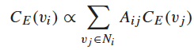
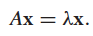
EIGENVECTOR CENTRALITY
A vertex’s importance is determined by the importance of the friends of that vertex
If one has many important friends, he should be important as well.
The centrality corresponds to the top eigenvector of the adjacency matrix A.
A variant of this eigenvector centrality is the PageRank score.

Slide 31
NETWORKX: CENTRALITY
Many other centrality measures implemented for you!
https://networkx.github.io/documentation/development/reference/algorithms.centrality.html
Degree, in-degree, out-degree
Closeness
Betweenness
Applied to both edges and vertices; hard to compute
Load: similar to betweenness
Eigenvector, Katz (provides additional weight to close neighbors)

Slide 32

STRENGTH OF RELATIONSHIPS

Slide 33
WEAK AND STRONG TIES
In practice, connections are not of the same strength
Interpersonal social networks are composed of strong ties (close friends) and weak ties (acquaintances).
Strong ties and weak ties play different roles for community formation and information diffusion
Strength of Weak Ties [Granovetter 1973]
Occasional encounters with distant acquaintances can provide important information about new opportunities for job search

Slide 34
CONNECTIONS IN SOCIAL MEDIA
Social media allows users to connect to each other more easily than ever.
One user might have thousands of friends online
Who are the most important ones among your 300 Facebook friends?
Imperative to estimate the strengths of ties for advanced analysis
Analyze network topology
Learn from User Profiles and Attributes
Learn from User Activities

Slide 35
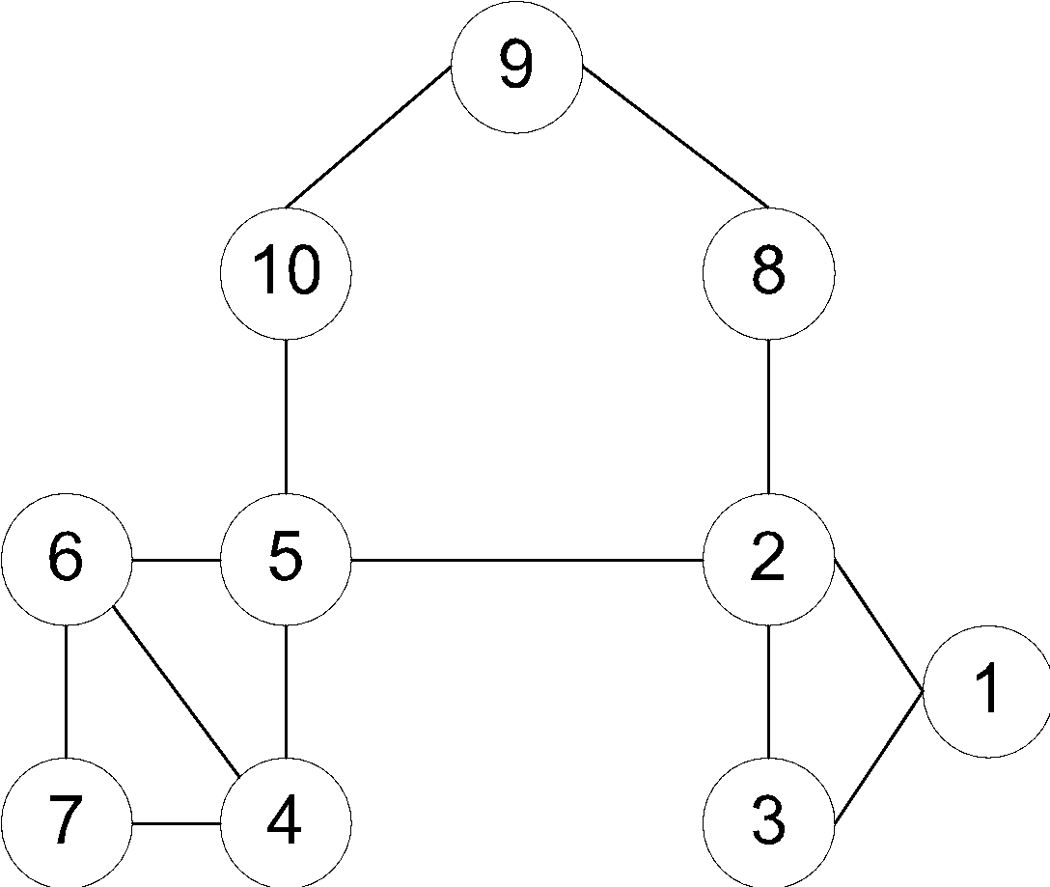
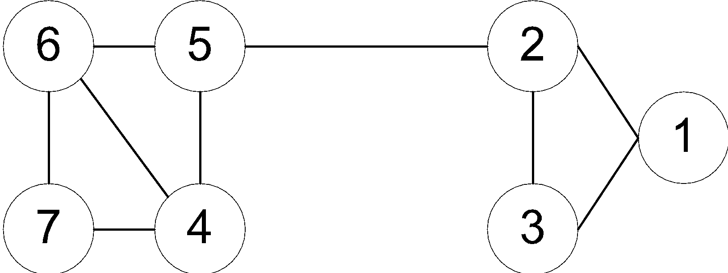
LEARNING FROM NETWORK TOPOLOGY
Bridges connecting two different communities are weak ties
An edge is a bridge if its removal results in disconnection of its terminal vertices
Bridge edge(s) ?????
Bridge edge(s) ?????

Slide 36
“SHORTCUT” BRIDGE
Bridges are rare in real-life networks
Idea: relax the definition by checking if the distance between two terminal vertices increases if the edge is removed
The larger the distance, the weaker the tie is
Example:
d(2,5) = 4 if (2,5) is removed
d(5,6) = 2 if (5,6) is removed
(5,6) is a stronger tie than (2,5)

Slide 37
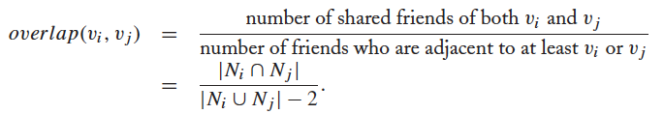
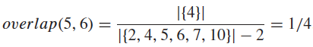
NEIGHBORHOOD OVERLAP
Tie strength can be measured based on neighborhood overlap; the larger the overlap, the stronger the tie is.
(-2 in the denominator is to exclude v_{i} and v_{j})
Example:

Slide 38
LEARNING FROM PROFILES AND INTERACTIONS
Twitter: one can follow others without followee’s confirmation
The real friendship network is determined by the frequency two users talk to each other, rather than the follower-followee network
The real friendship network is more influential in driving Twitter usage
Strengths of ties can be predicted accurately based on various information from Facebook
Friend-initiated posts, message exchanged in wall post, number of mutual friends, etc.
Learning numeric link strength by maximum likelihood estimation
User profile similarity determines the strength
Link strength in turn determines user interaction
Maximize the likelihood based on observed profiles and interactions

Slide 39
LEARNING FROM PROFILES AND INTERACTIONS
Thought experiment and discussion
You are tasked with creating a bot-finding metric for Twitter
The only information you have available (in this thought experiment) is the graph of ‘follow’ relationships
What measure of centrality (or combination thereof) do you use to point the way for bot-finders? Discuss.
If we add edges for interactions, does that change anything for you?

Slide 40
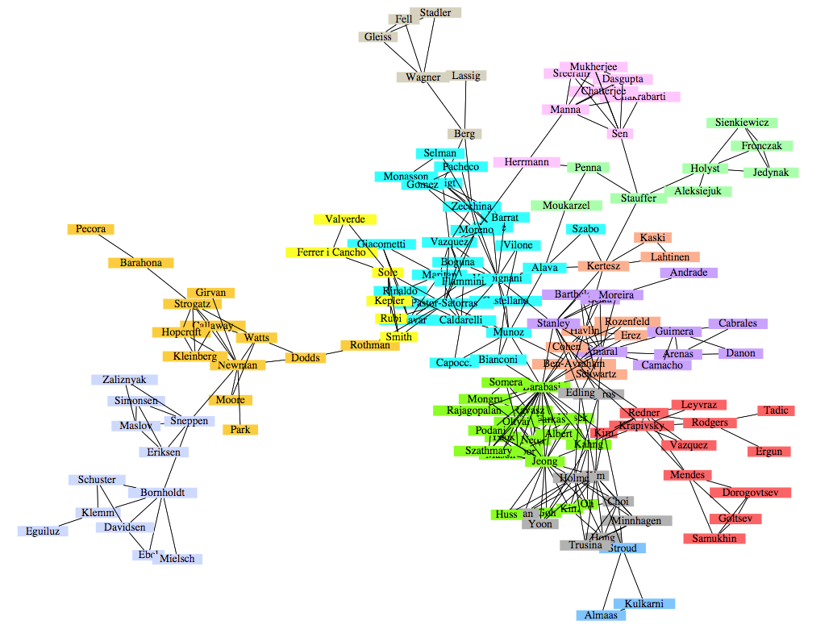
COMMUNITY DETECTION
A co-authorship network of physicists and mathematicians
(Courtesy: Easley & Kleinberg)

Slide 41
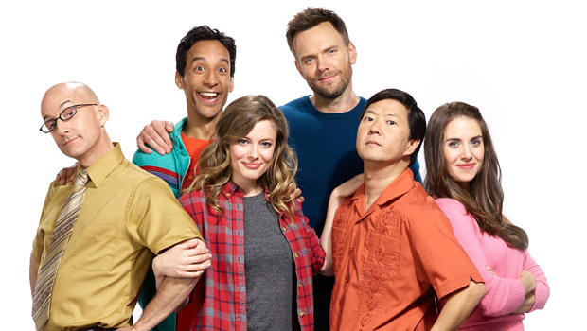
WHAT IS A COMMUNITY?
Informally: “tightly-knit region” of the network.
How do we identify this region?
How do we separate tightly-knit regions from each other?
It depends on the definition of tightly knit.
Regions can be nested
Examples ?????????
How do bridges fit into this ?????????

Slide 42
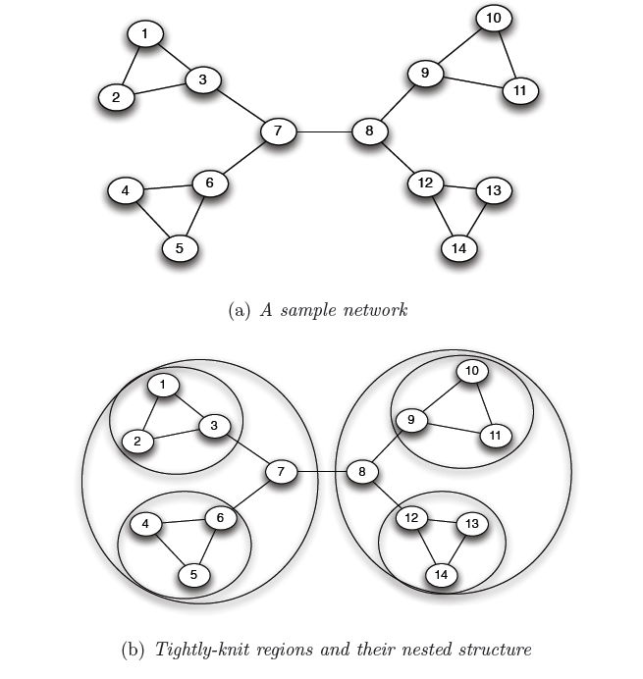
WHAT IS A COMMUNITY?
Removal of a bridge separates the graph into disjoint components
bridges
An example of a nested structure of the communities
(Courtesy: Easley & Kleinberg)

Slide 43
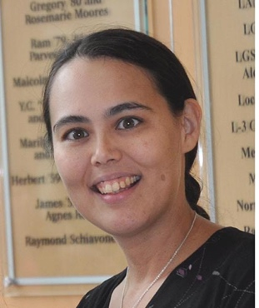

COMMUNITY DETECTION
Girvan-Newman Method
Remove the edges of highest betweenness first.
Repeat the same step with the remainder graph.
Continue this until the graph breaks down into individual nodes.
As the graph breaks down into pieces, the tightly knit community structure is exposed.
Results in a hierarchical partitioning of the graph
Michelle Girvan

Slide 44
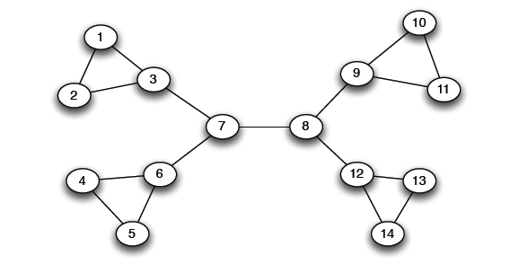
GIRVAN-NEWMAN METHOD
Betweenness(7-8)= 7*7 = 49
Betweenness(1-3) = 1*12 = 12
Betweenness(3-7) = Betweenness(6-7) =
Betweenness(8-9) = Betweenness(8-12) = 3*11= 33

Slide 45
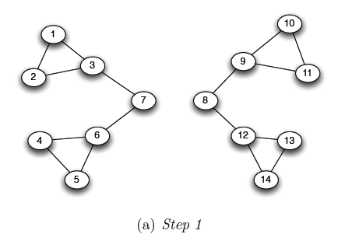
GIRVAN-NEWMAN METHOD
Betweenness(1-3) = 1*5=5
Betweenness(3-7) = Betweenness(6-7) =
Betweenness(8-9) = Betweenness(8-12) = 3*4 = 12

Slide 46
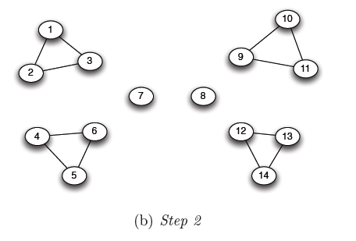
GIRVAN-NEWMAN METHOD
???????????????????
Betweenness of every edge = 1

Slide 47
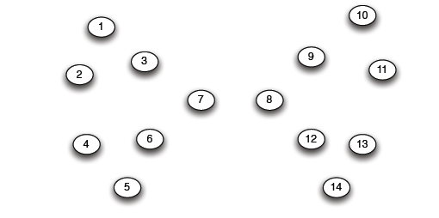
GIRVAN-NEWMAN METHOD
G=nx.Graph()
# Returns an iterator over partitions at
# different hierarchy levels
nx.girvan_newman(G)

Slide 48
NETWORKX: VIZ
Can render via Matplotlib or GraphViz
Many different layout engines, aesthetic options, etc
https://networkx.github.io/documentation/networkx-1.10/reference/drawing.html
https://networkx.github.io/documentation/development/gallery.html
import matplotlib.pyplot as plt
G=nx.Graph()
nx.draw(G, with_labels=True)
# Save to a PDF
plt.savefig(“my_filename.pdf”)

Slide 49
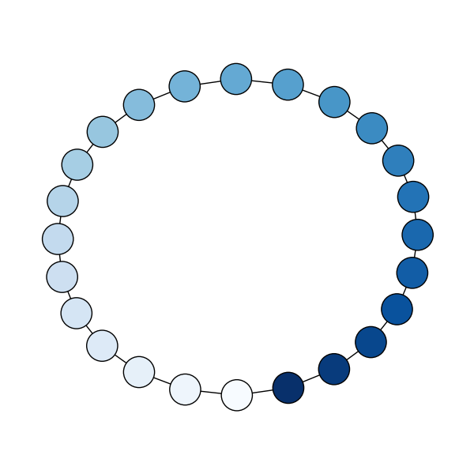
NETWORKX: VIZ
# Cycle with 24 vertices
G=nx.cycle_graph(24)
# Compute force-based layout
pos=nx.spring_layout(G,
iterations=200)
# Draw the graph
nx.draw(G,pos,
node_color=range(24),
node_size=800,
cmap=plt.cm.Blues)
# Save as PNG, then display
plt.savefig(”graph.png")
plt.show()

Slide 50
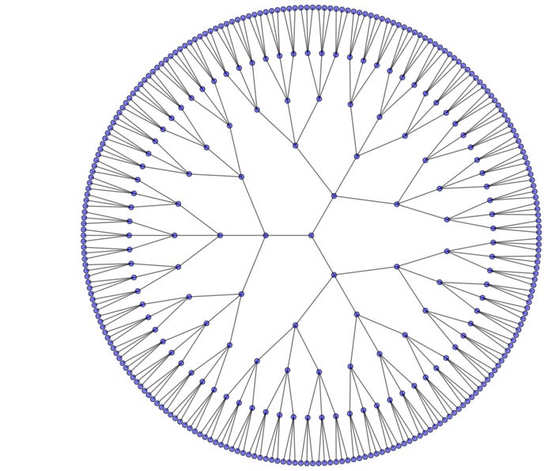
NETWORKX: VIZ
# Branch factor 3, depth 5
G = nx.balanced_tree(3, 5)
# Circular layout
pos = graphviz_layout(G,
prog='twopi', args='')
# Draw 8x8 figure
plt.figure(figsize=(8, 8))
nx.draw(G, pos,
node_size=20,
alpha=0.5,
node_color="blue",
with_labels=False)
plt.axis('equal')
plt.show()

